Slide 1
Automated Attendance
System
Abhiraj R V
Nibin bin Riyas A K
Arya S S
Divya Dileep
Parvathy J N
Group no:6

Slide 2
INTRODUCTION
EXISTING SYSTEM
PROPOSED SYSTEM
CONTRIBUTION
TECHNOLOGY
MODULES
DESIGN
-BLOCK DIAGRAM
-DATA FLOW DIAGRAM
-FLOWCHART
-implementation
CONCLUSION
CONTENTS

Slide 3
Introduction
The project focuses on building an attendance system using image processing and cloud computing.The image of each student entering into class will be taken by webcamera and prior to that the image of each student will be processed on cloud storage and dashboard access.When the image captured by camera is matched with image stored in the cloud attendance will be marked.A webpage for this purpose can be created and using Rest API this web page can be converted to an application controlled by respective staff.

Slide 4
Problem statement
The project is intended to overcome the failures and downs in taking attendance of students nowadays.The large and messed up classroom make the attendance marking process a tedious one.So through this system an effective and time valued proposal is made.

Slide 5
Existing System
The existing system for marking attendance is either done manually by the staff or there exist some finger scanning system.Both are time consuming and hectic.If the class room is messed up all these activities will raise difficulties.Also data entered may be not correct and attendance can be missed or re entered.Also many manipulation can be there if the classroom is very large.Also marking of attendance always proved to be very hectic as teachers my lose plenty of their precious time.So in order to overcome this a well standardized way of marking attendance is provided through image processing

Slide 6
Proposed System
This system will make the marking of attendance more easier by establishing an error free marking of the attendance
A web camera will be placed on the top of the classroom
It has Ir sensors and sometime sensor is used to detect students
Raspberry pi is used as an embedded device
Now raspberry pi is connected to camera by using libfreenect
Cloud storage is there for storing the images

Slide 7
Proposed system
cloud can be used to store the images of each student in a class
Using cloud computation we can feed image of each student into the database
When the camera capture the image then it will be matched with Image stored in the cloud
The datas present in the cloud will be converted to a dynamic webpage
Using rest API convert this webpage into an application

Slide 8
Contribution
The main parts are web camera,raspberry pi,sensors,cloud,dashboard
The application will be available on the mobile phones of staff
Attendance will be available on application itself
Otherwise error message will be displayed
A full dynamic view of image will be provided
Automation can be made effective

Slide 9
Technology
Domain:Android app development Image processing,Cloud computing
Software:java(JEE),android studio python ,php,html
Hardware:web camera,Raspberry pi,sensor
Assisted by:Wired networks,Rest API,open cv
Application:Attendance System,security,Automated

Slide 10


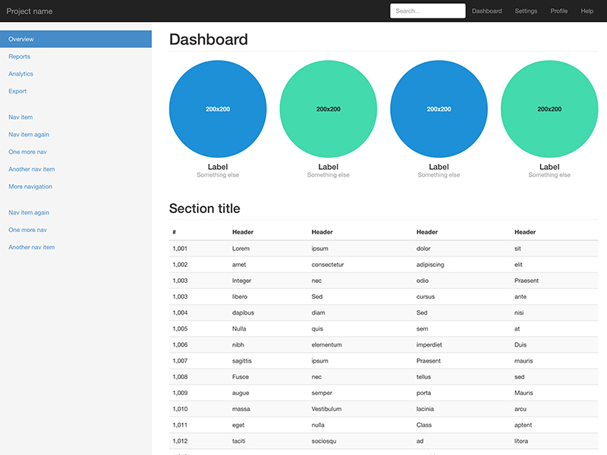
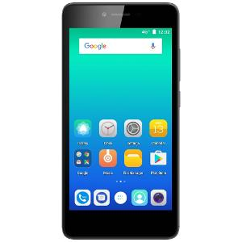
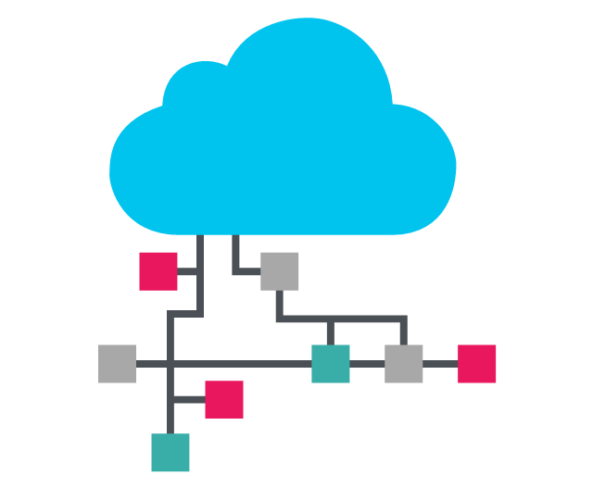
The proposed system

Slide 11
Modules
Raspberry pi(IoT device)
Website
Cloud Service
Android Application

Slide 12
Raspberry pi module
Camera
Cloud
Raspberry pi
Sensor

Slide 13
Raspberry pi module
Deals with image processing and data testing and training
It forms the primary module in which the image of each student is taken and mapped to userid
When matching is done image will be stored in the cloud
Image will be captured using a standard webcam
Viola Jones is the algorithm used for training and further processing
Based on certain features the image will be identified
Rasberry pi forms the IoT device in the entire project

Slide 14
The Viola Jones algorithm for face detection
Three main ideas:
• introduction of a new image representation called the Integral Image
• simple and efficient classifier which is built using the AdaBoost learning algorithm
• method for combining classifiers in a “cascade” which allows background regions of the image to be quickly
discarded
Operating on 384x288 pixel images, faces
are detected at 15 frames per second on a 700 MHz Intel
Pentium III
Features
The simple features used are reminiscent of Haar basis functions
• two-rectangle feature: difference between the sum of the pixels within two rectangular regions
• three-rectangle feature: sum within two outside rectangles subtracted from the sum in a center rectangle
• four-rectangle feature: difference between diagonal pairs of rectangles.

Slide 15
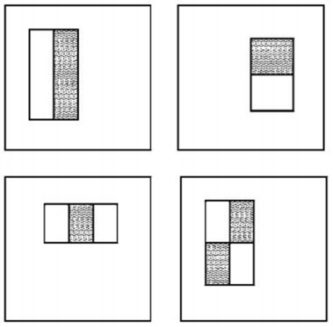
Given that the base resolution of the detector is 24×24, the exhaustive set of features is quite large, 160,000
• a very efficient way to compute them is needed -> integral image
• only the useful ones have to be used -> AdaBoost

Slide 16


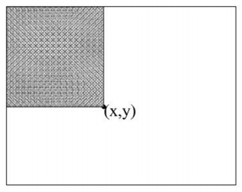
Integral image The integral image at location x , y contains the sum of the pixels above and to the left of x , y, inclusive: Using the following pair of recurrences: where s(x , y) is the cumulative row sum, the integral image can be computed in one pass over the original image

Slide 17
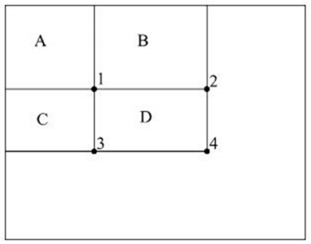
Integral image The sum of the pixels within rectangle D can be computed with four array references: • The value of the integral image at location 1 is the sum of the pixels in rectangle A. The value at location 2 is A + B, at location 3 is A + C, and at location 4 is A + B + C + D. • The sum within D can be computed as 4 + 1 − (2 + 3).

Slide 18
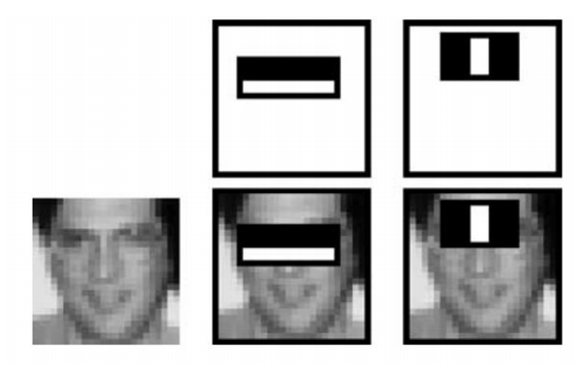
A two-rectangle feature can be computed in six array references – for any scale!
A very small number of these features can be combined to form an effective classifier. The main challenge is to find these features.
A variant of AdaBoost is used both to select the features and to train the classifier.
The first two features selected by AdaBoost for the task of face detection are easily interpreted:
• first feature: the region of the eyes is often darker than the region of the nose and cheeks
• second feature: the eyes are darker than the bridge of the nose.

Slide 19
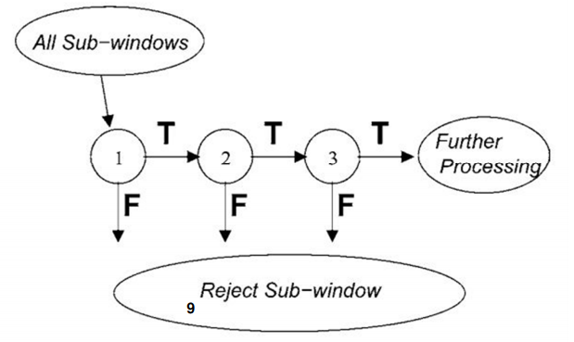
Cascaded classifier Smaller, and therefore more efficient, classifiers can be constructed which reject many of the negative subwindows while detecting almost all positive instances: • simpler classifiers are used to reject the majority of subwindow • then, more complex classifiers are called upon to achieve low false positive rates.
T: true
F: false

Slide 20
The cascaded classifier for face detection … has 38 layers and 6060 features: • first classifier: two features, rejects about 50% of non-faces (while correctly detecting close to 100% of face • second classifier: ten features, rejects 80% of non-faces • 3rd and 4th: 25 features

Slide 21
Website module
Cloud
Website
user

Slide 22
Website module
Using pHP and HTML a basic web page is developed within the local server
The purpose is to enter the details of the teachers and the students and store the details in database
The details will be stored in the database for further access by the cloud
This is for the integration and importing of data to the cloud which will become valid only if the image matches with the uid provided in the database

Slide 23
Cloud Computing module
Website
Cloud
Raspberry pi
Mobile App

Slide 24
Cloud computing
This the the module which provides service to the mobile application to access the data of teachers and students
In the cloud the local server will be imported
Using various GET and POST requests the data can be accessed by the application
Cloud forms a service through which the data can be accessed from anywhere
Cloud forms the basics of the concept Iot in which the data items manage to be fetched from anywhere

Slide 25
Mobile application module
Cloud
User
Mobile App

Slide 26
Mobile application
This is the final module which forms the result
It contains login page for admin and teachers so that the corresponding teacher list and the student list can be viewed
It is the presentation part of the whole Iot concept
Application access data from the cloud
Application can be used only for the teachers
Application provides convenience to the user in terms of taking attendance as chance of error is less

Slide 27
Design(block diagram)
camera
Application
CLOUD PLATFORM
Raspberry pi
Sensor - camera
Iot device-pi
Gateway-internet connection
Cloud-AWS
Presentation-Application
Web page

Slide 28
Design(DFD)
LEVEL 0
User
visit
Image signal
Environment
Attendance app
LEVEL 1
person identify 1.1
Image signal
data
Attendance app
Cloud process1.2
Web page 1.3
Computation data

Slide 29
DFD
LEVEL 2
Image taken
Image store
Data collection
Person identification 1.1
Image feature
Train system 1.1.1
Extracted feature
Testing 1.1.2
database
result

Slide 30
DFD
application2.1.1
req/reply
LEVEL 2
Teacher db
cloud
data
Student db
request
Web page2.2.2

Slide 31
DFD
LEVEL 3
info
feature
data
Image input
Train system3.1
Create db 3.1.1
Extract feature 3.1.2
Value storage
value
data
Image input
testing4.1
Extract feature4.2.2
Db compare4.1.1
Value storage

Slide 32
DFD
LEVEL 3
request
Application 5.1
Teacher db
result
result
Application 5.2
Student db
request

Slide 33
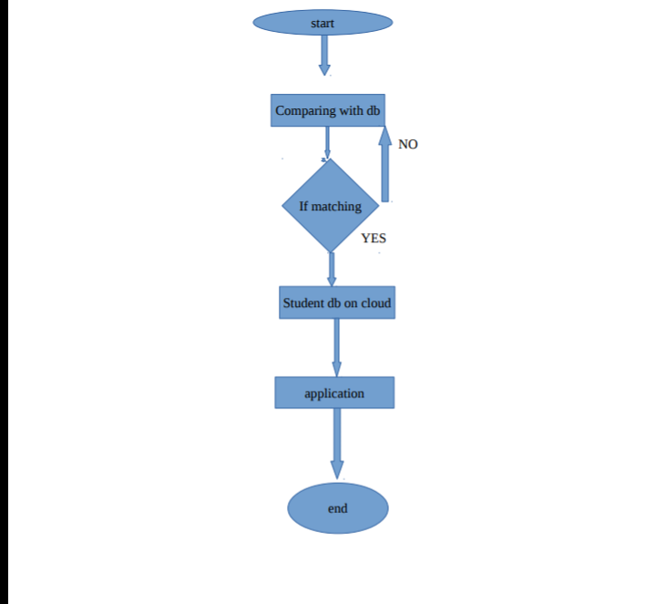
FLOWCHART

Slide 34
Flowchart
Image data
No
Uid matches
yes
Cloud data
Admin login
Teacher login
discard
No
valid
No
valid
Yes
Yes
Application Access

Slide 35
Database design
Student
column name | datatype
uid | INT | primary key,NOT_NULL
name | VARCHAR | NULL
gender | VARCHAR | NULL
department | VARCHAR | NULL
year | VARCHAR | NULL
attendance | VARCHAR | NULL
username | VARCHAR | NULL
password | VARCHAR | NULL

Slide 36
Teacher
column name | datatype
uid | INT | primary key,NOT_NULL
name | VARCHAR | NULL
gender | VARCHAR | NULL
department | VARCHAR | NULL
subject | VARCHAR | NULL
mobile number | INT | NULL
username | VARCHAR | NULL
password | VARCHAR | NULL

Slide 37
Login
column name | datatype
uid | INT | primaey kery,NOT_NULL
username | VARCHAR | NULL
password | VARCHAR | NULL

Slide 38
Admin login
column name | datatype
name | VARCHAR | NULL
username | VARCHAR | NULL
password | VARCHAR | NULL

Slide 39
IMPLEMENTATION
ANDROID APPLICATION

Slide 40
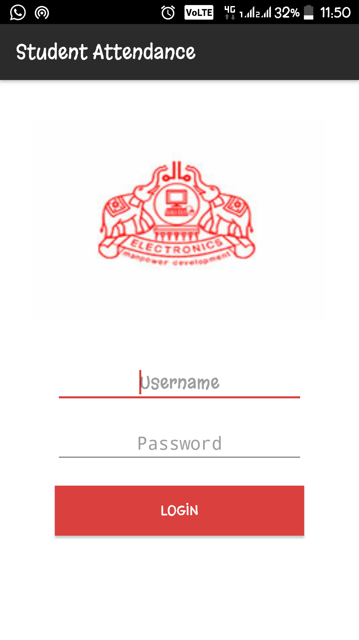
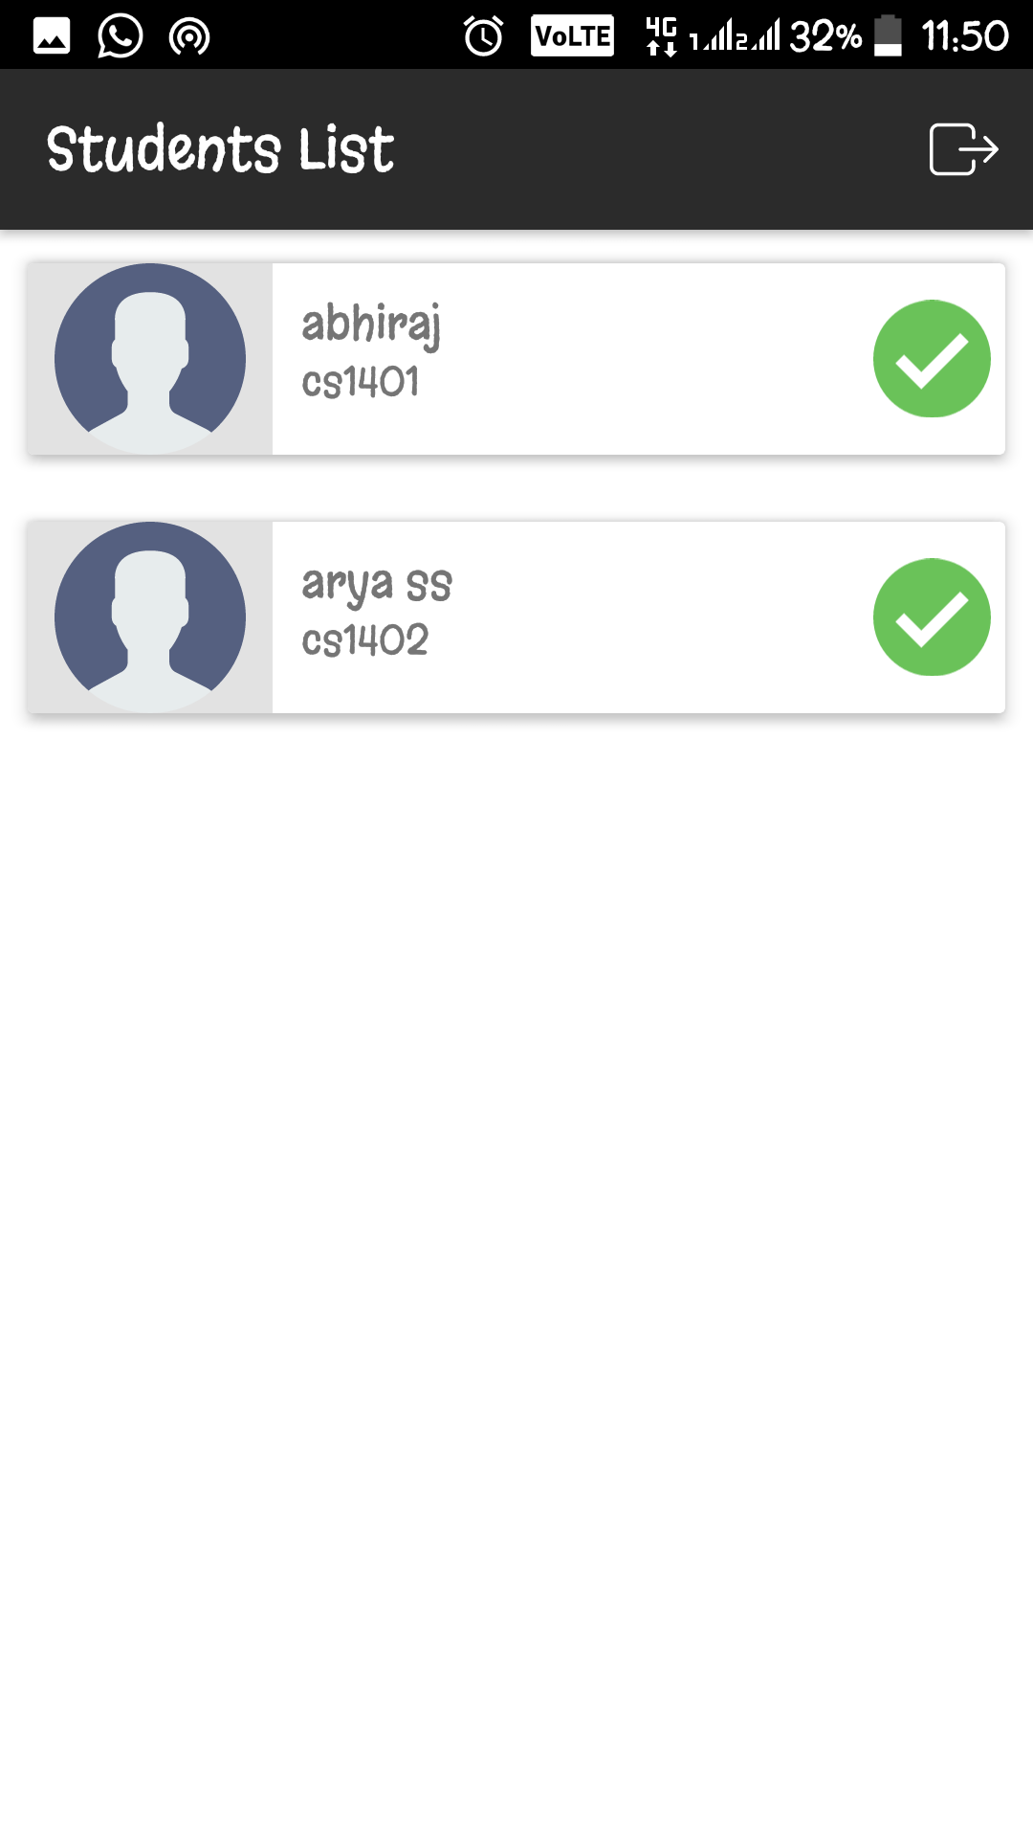
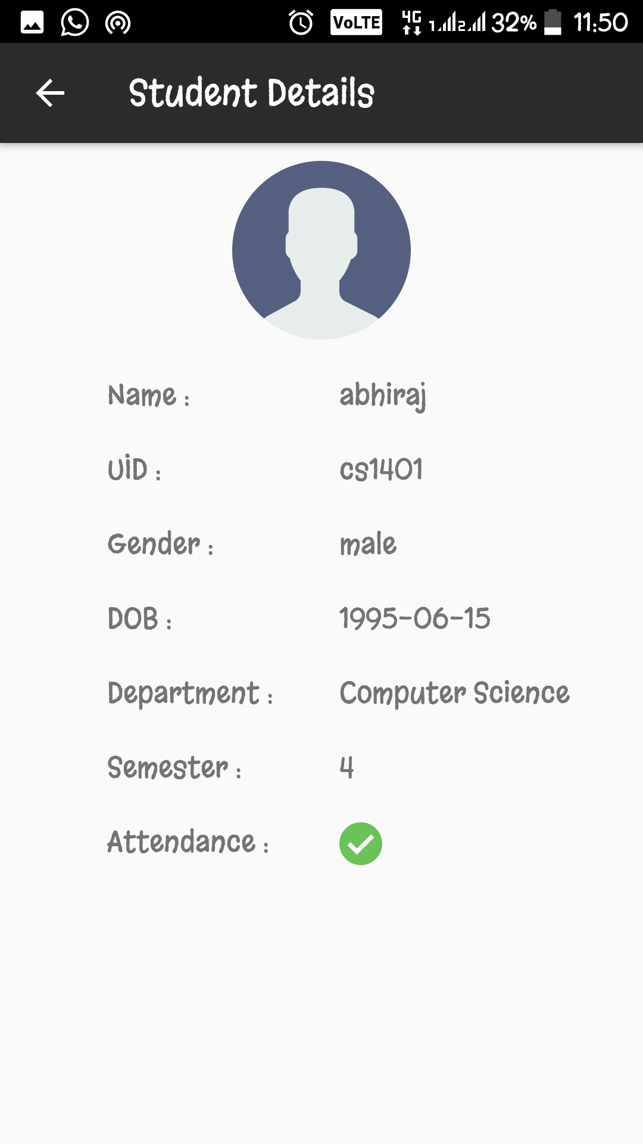

Slide 41
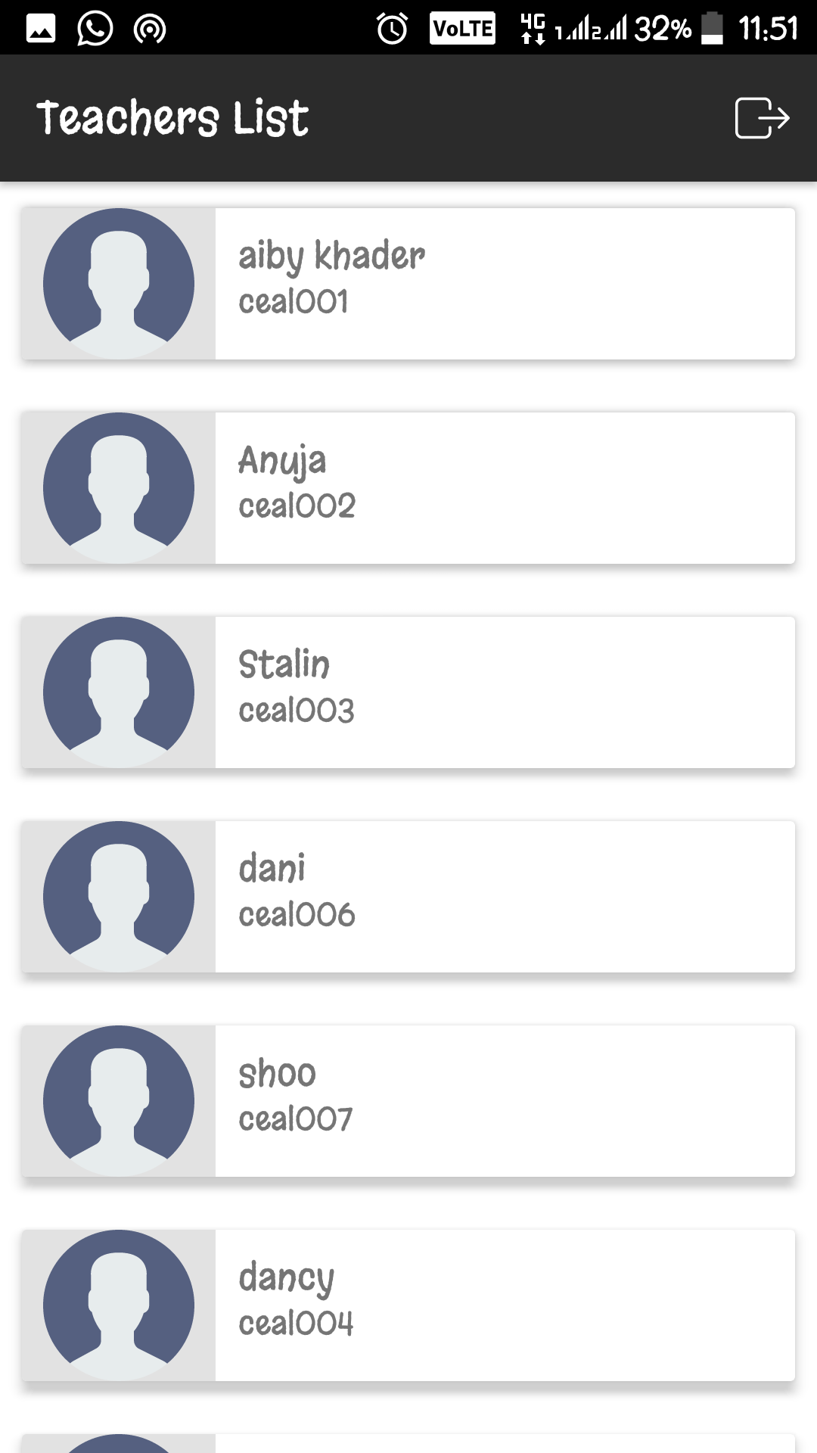
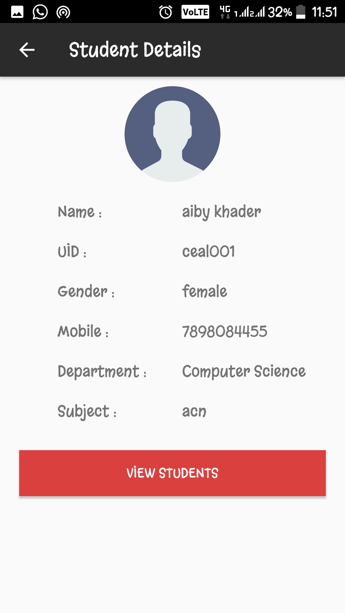

Slide 43
WEBSITE

Slide 44
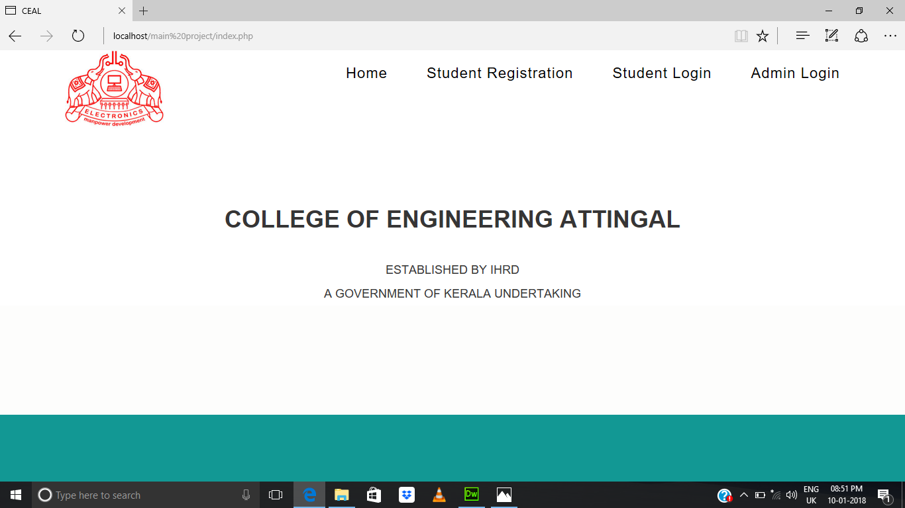

Slide 45
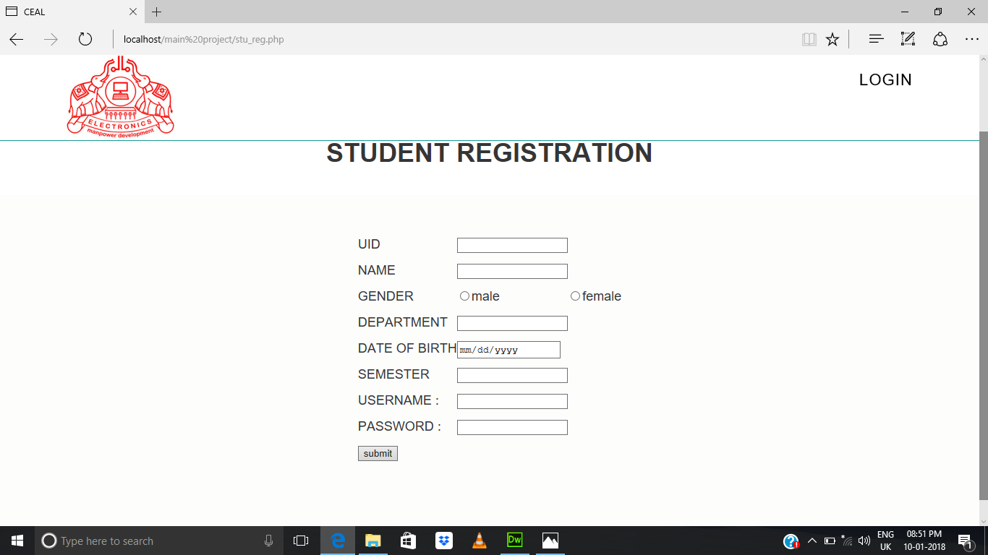

Slide 46
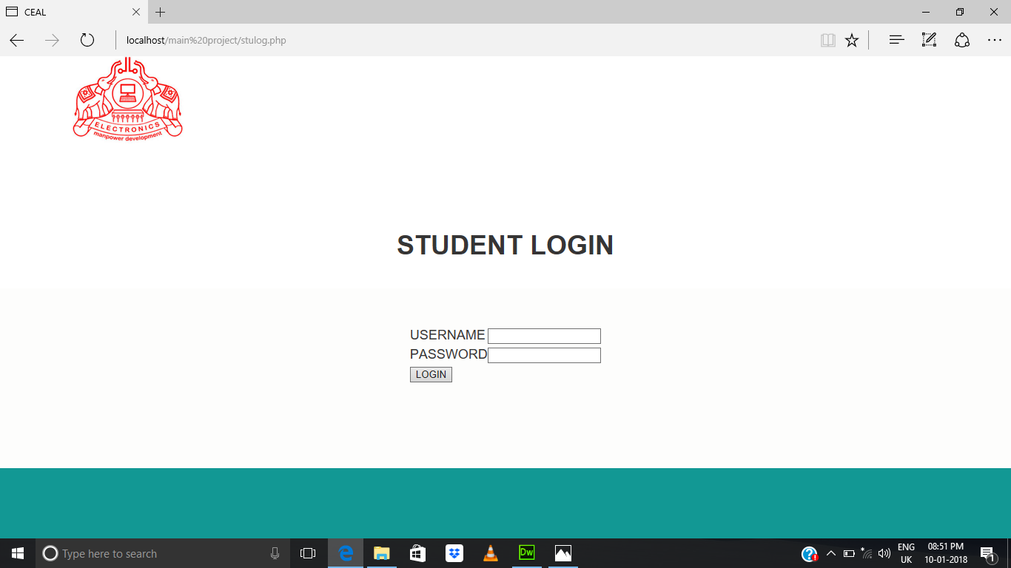

Slide 47
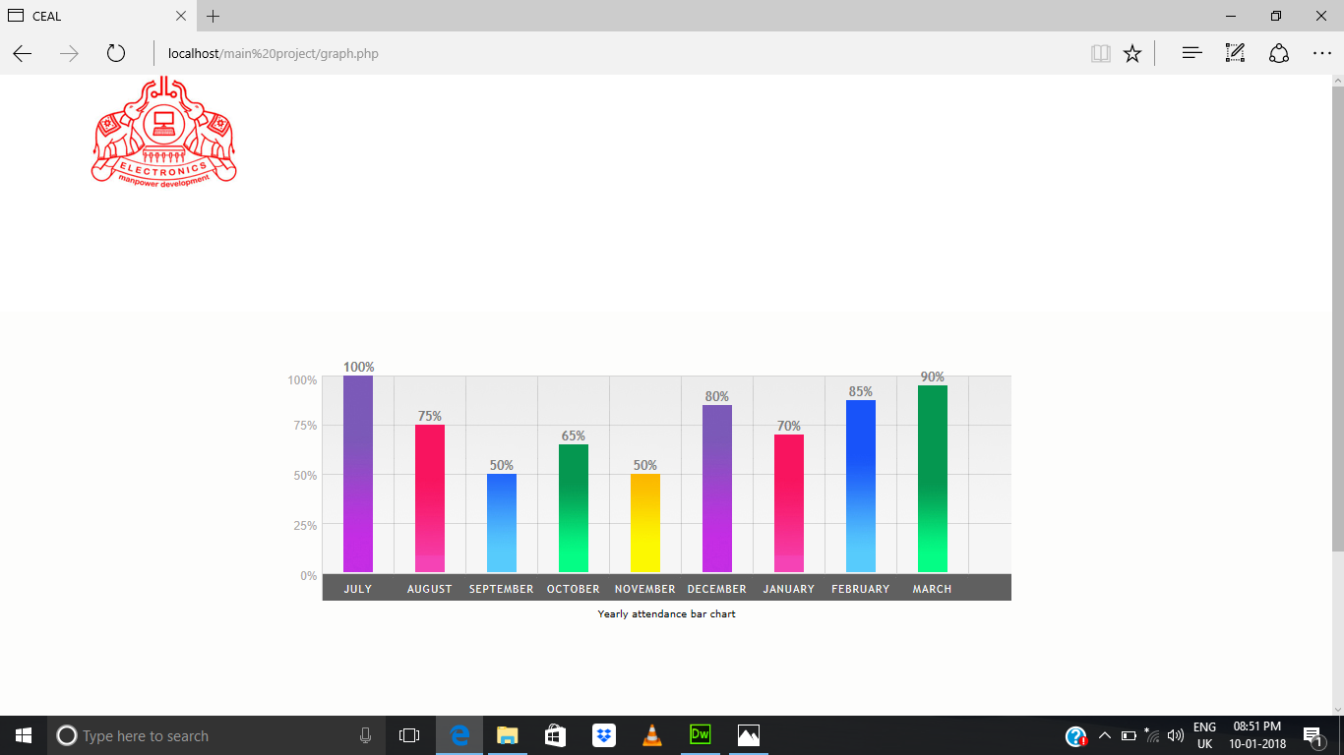

Slide 48


Slide 49
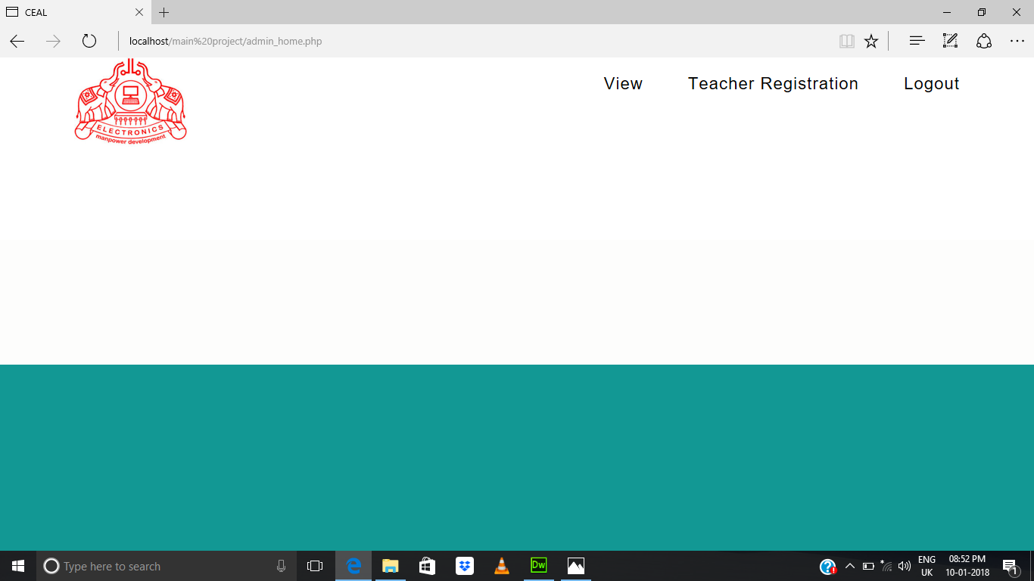

Slide 50


Slide 51
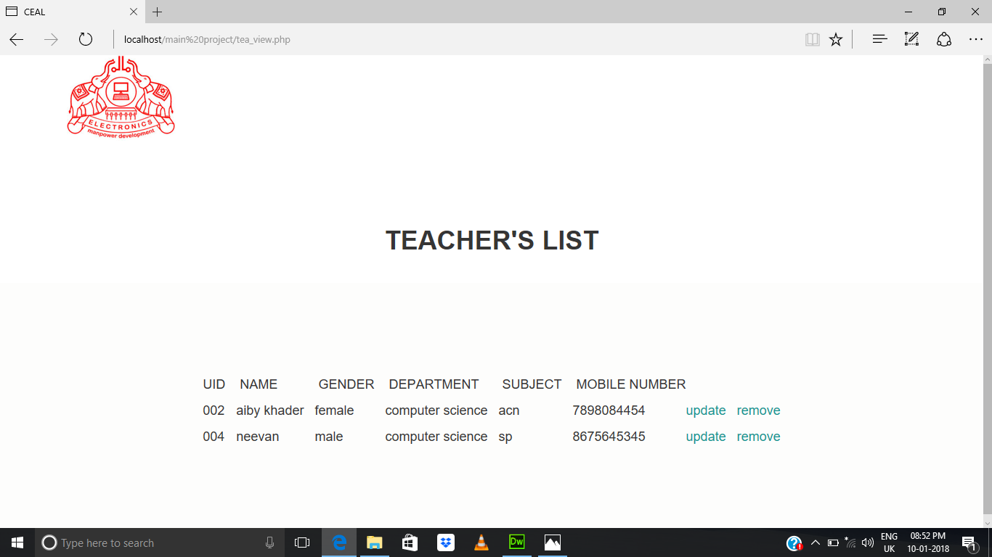

Slide 52
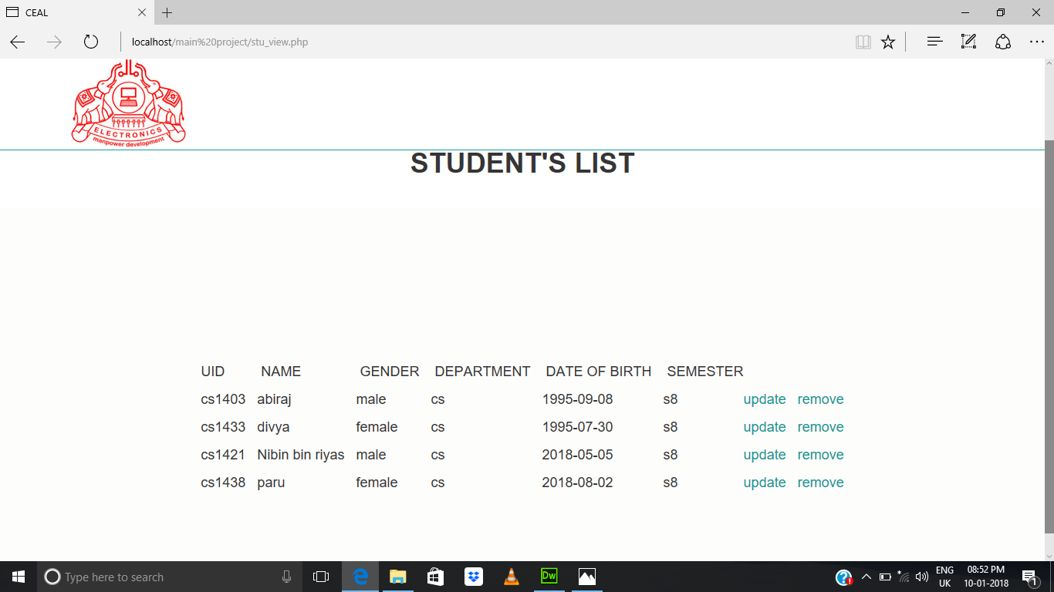

Slide 53
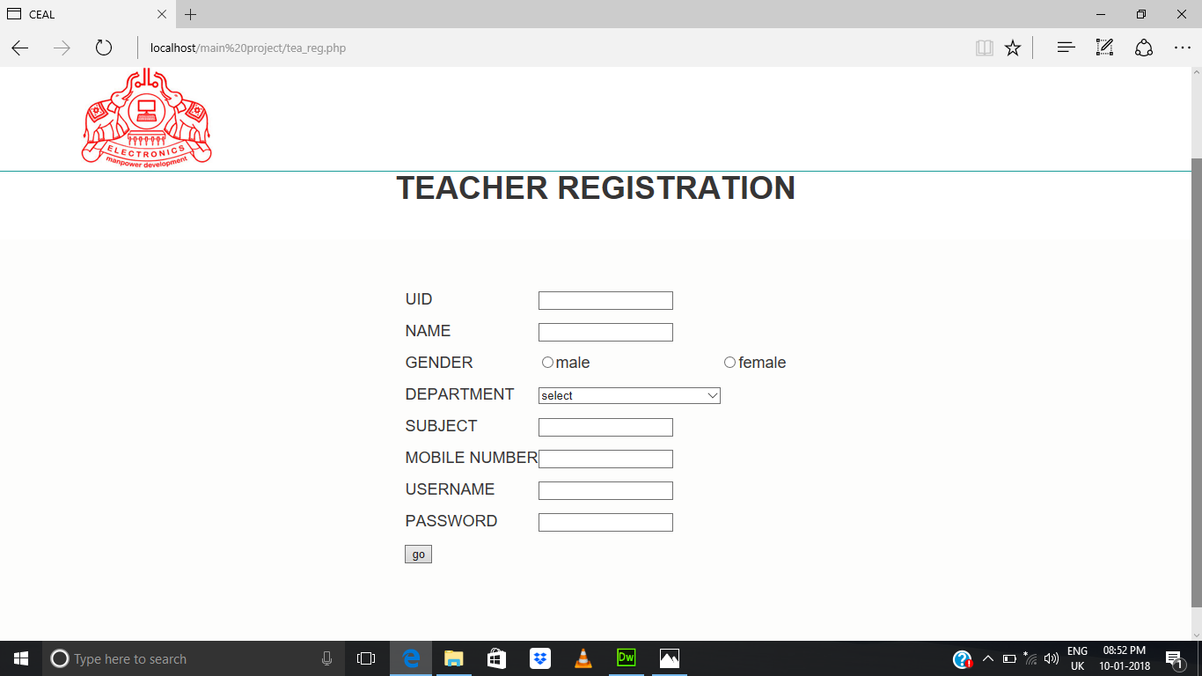

Slide 54
Conclusion
The project mainly focuses on how to ease a task in our day to day life.The prime factor is one of the key issue in many of the educational institution.The attendance system is made more dynamic and rapid in the sense that it becomes easily controllable.The stress on every staff is reduced very much and a very good flow of information is provided.In future more systematic way like video capturing of students can be included.

